Slide 1
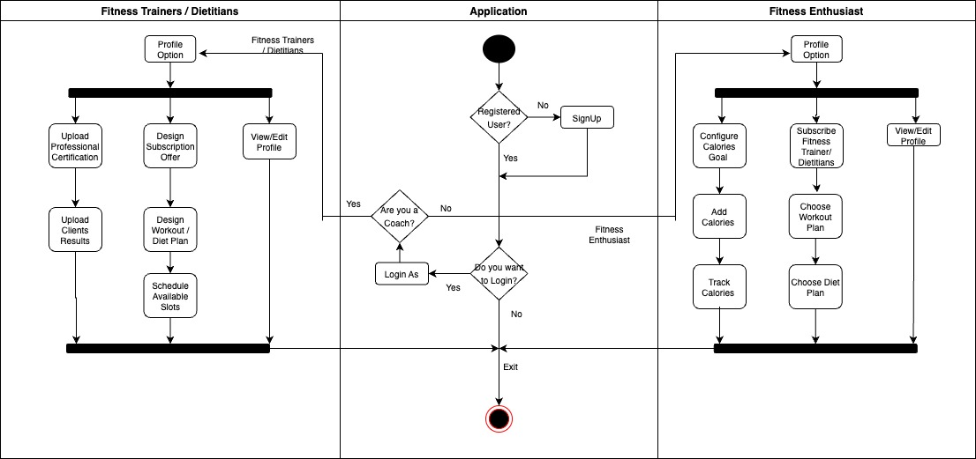
Activity diagram Health App Application Activity

